Slide 1
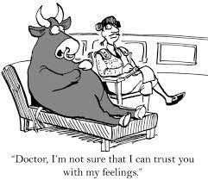
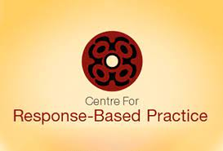
The only Problem with Psychology…
…is Psy-chology
From “Psy-colonisation”
To “De-psy-colonisation”

Slide 2
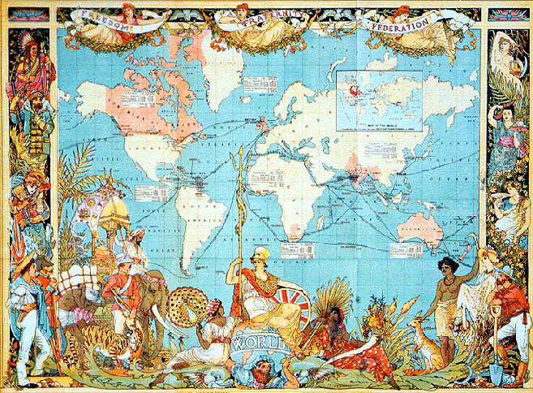
The colonial code in the helping professions…
You are deficient; I am proficient…
Therefore, I have the right (duty, mandate, task) of performing certain operations on you (labelling/diagnosing, fixing, assigning, directing, surveilling)…
For your own good!
(Todd & Wade, 1997)

Slide 3
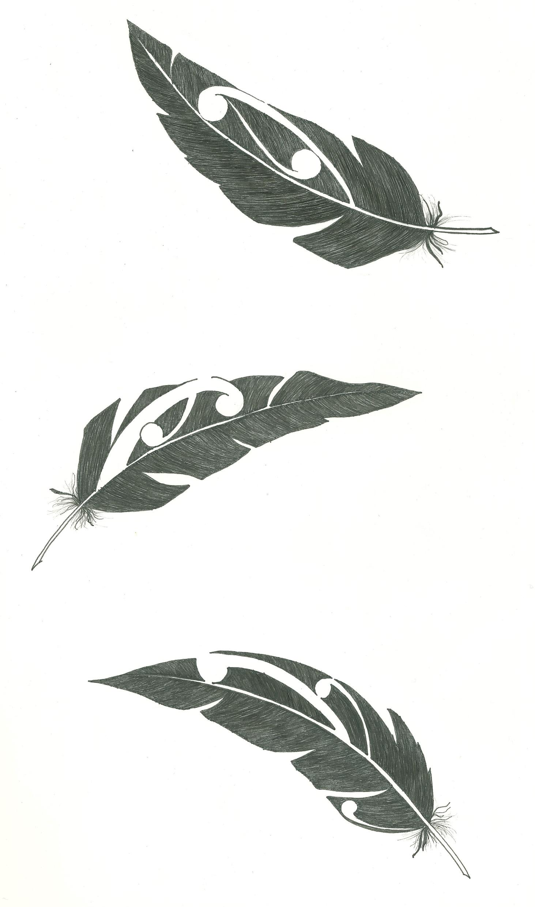
History & evolution of psy-colonisation
Psychology & Psychoanalysis 1800s > subject to object
Mind-body dualism > embodiment, tail does not wag the dog
Benign Eurocentric theories - Wundt, Freud, James, Piaget, Adler, Skinner...
Attributes behaviours outside of the privileged mainstream as ‘normal’ or ‘abnormal’ functioning
Over focus on diagnoses, psychometrics, medication, genetics & neuroscience
Intersectionality between medicine, the medicalisation of the mind, capitalism, and colonisation (liquid modernity)
Upholds trauma informed cognitive behavioural talk theories as best practice
Does not acknowledge genocide, colonial oppression and the insatiable desire for Social Justice
Non-contextual – excludes connections to culture, whakapapa / whenua / the natural world

Slide 4
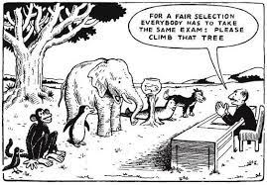

Slide 5
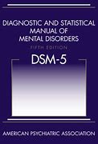

Predominantly, the DSM has been based on consensus amongst psychiatrists, surveys, and not actual science.
The suffering is real, consensus is not science.
White male voices were the loudest in these “discussions” of consensus (Davis, 2020).
No biological evidential tests to back up mental health diagnoses.
The serotonin theory promoted by GlaxoSmithKline direct to consumer marketing not research, remains unaddressed.

Slide 6
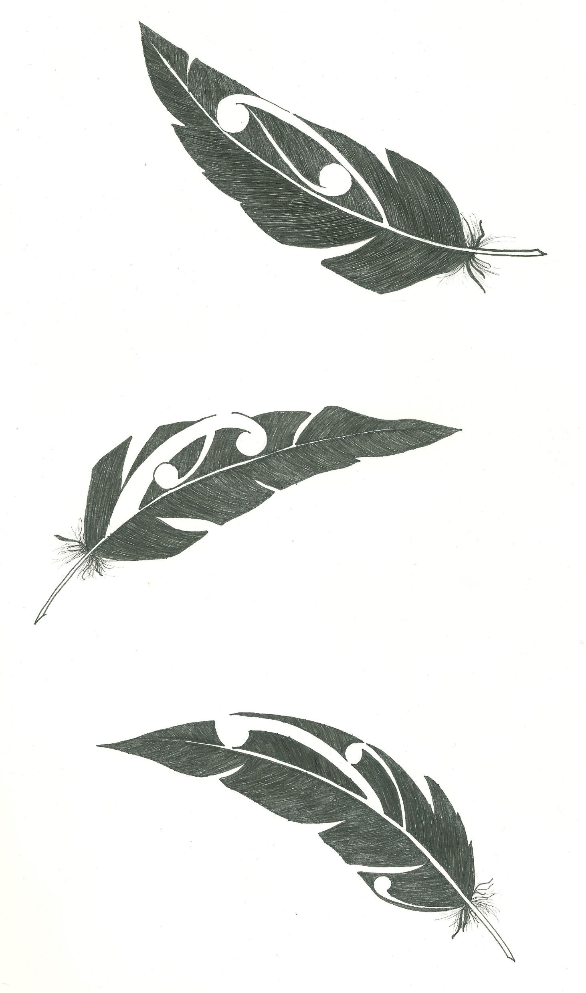
Western psychology recasts resistance into mental illness or signs of deficiency
Drapetomania was a conjectural mental illness that, in 1851, American physician Samuel A. Cartwright hypothesized as the cause of black slaves fleeing captivity. ^{:41} It has since been debunked as pseudoscience ^{:2} and part of the edifice of scientific racism.

Slide 7
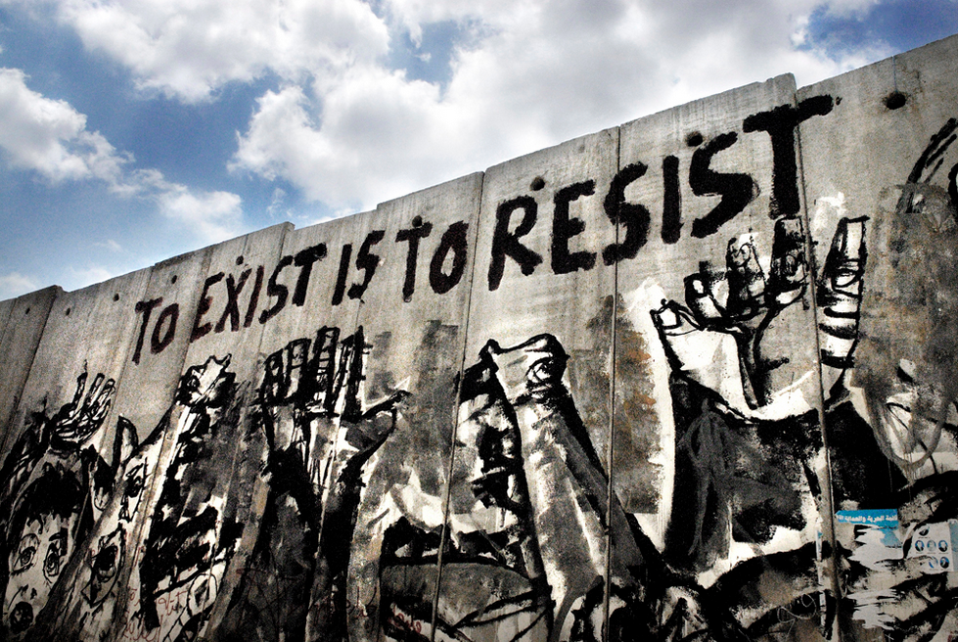

Slide 8
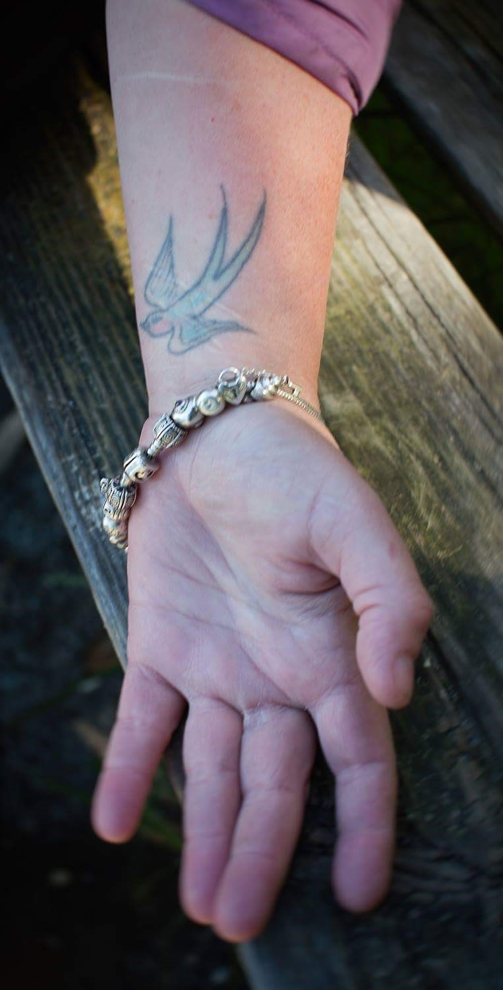
Kiri’s Story
Dx PTSD w dissociative, PDD
Questioned BPD?
Comorbidities Enuresis, Asthma
Outbursts / Anger issues
Drugs & Alcohol
Impulsive, reckless behaviour
Complex needs, non-compliant MHS, Rehab / AoD treatment, community counselling

Slide 9
Four Operations of Language
Conceal / Reveal Violence
Blame, Pathologize / Contest Victim Responsibility
Obscure / Reveal Perpetrator Responsibility
Conceal / Highlight Victim’s Resistance

Slide 10

Response or effect?
“When he has sex on me I just play dead
and go somewhere else in my mind” (Ellen)

Slide 11
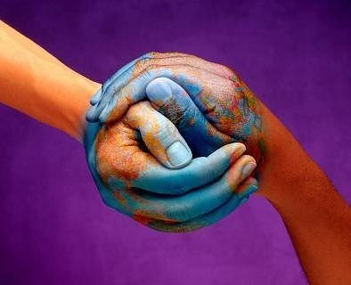
Why Focus on Social Responses to Victims?
The quality of social responses is the strongest single predictor of victim distress after violence

Slide 12
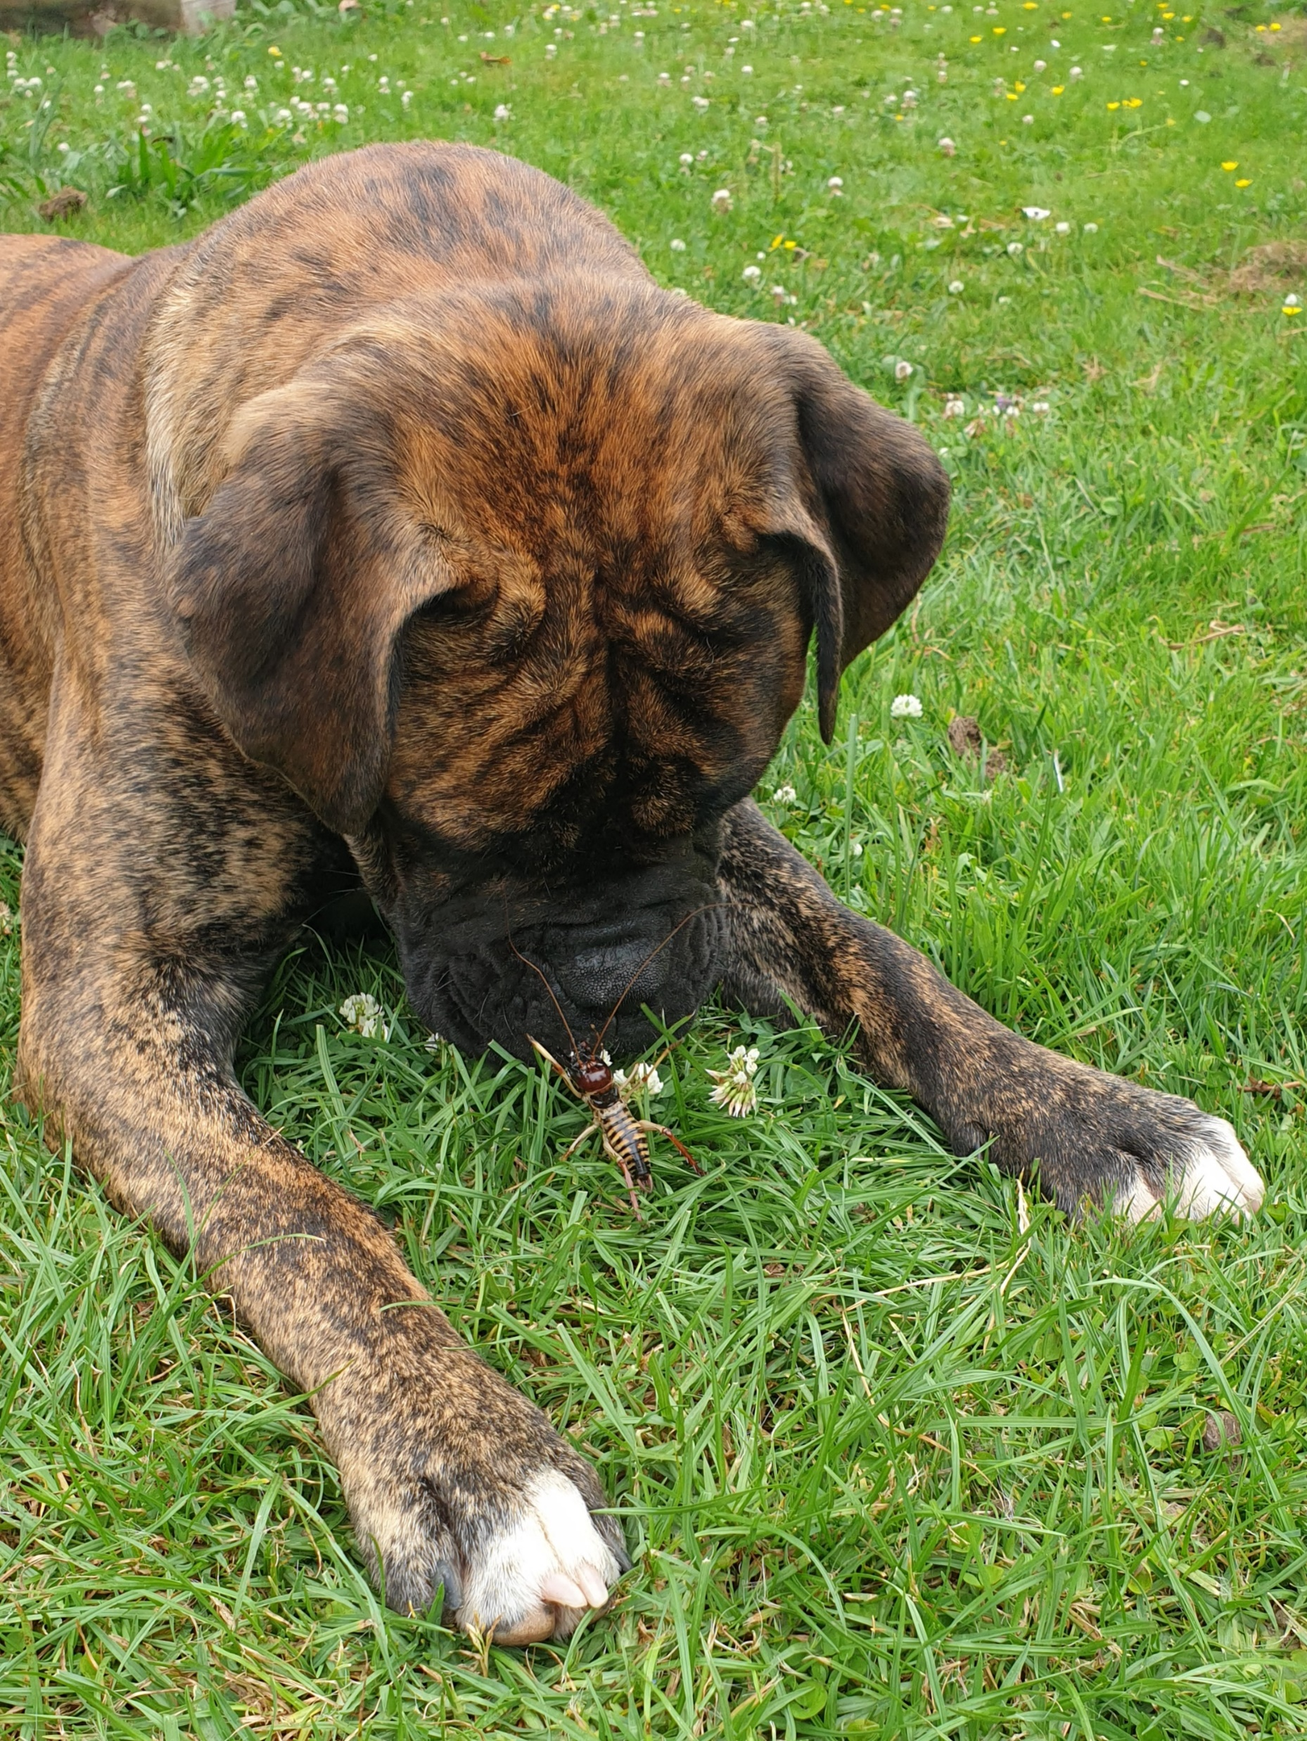
Centering mana
To uphold mana of other human beings… we look to their capacity, action, skills, intelligence, street smarts, teachings, knowledge – and all the ways they know how to navigate safety for themselves and their whānau
We can get to this by asking what they did, and how they knew to do this.
This is not resilience…. This is resistance! Resistance knowledges… safety knowledges.
Oppressed and mistreated people often form their identity through what they do… in resistance to adversity.
If we want to address violence and mistreatment, we have to focus on the social world… not on the mind of the victim.
Notes:
We use ”trauma” selectively to make mental health problems in Indigenous and marginalized populations. Do we talk about John A MacDonald and the founding fathers of the Canadian state as traumatized beings… even though they were separated from parents, put in boarding schools, they were victims of beatings, physical and sexual abuse in schools, exposed to and compliicit in atrocities in European wars (South Africa, Europe 1 and 11, colonizing in Indian, the Caribbean and around the world? No we don’t.

Slide 13


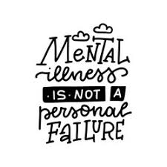














Slide 14
References / rauemi
Coates, L. & Wade, A. (2007). Language and violence: Analysis of four operations of discursive discourse. Journal of family violence, 22
Coates, L. & Wade, A. (2004). Telling it like it isn’t: obscuring perpetrator responsibility for violent crime. Discourse & society, 15, 499-526.
Coates, L., Todd, N. & Wade, A. (2003). Shifting terms: An interactional and discursive view of violence and resistance. Canadian review of social policy, 52, 116-121. 17.
Coates, L., Todd, N. & Wade, A. (2000). An interactional and discursive view of violence and resistance. Handout from Mind the gap: Spring Institute on Response-Based Practice, Cowichan Bay, BC.
Dupuis-Rossi, R. (2020) Indigenous historical trauma: A decolonizing therapeutic framework for Indigenous counsellors working with Indigenous clients. In S. Collins (Ed.), Embracing cultural responsivity and social justice. Pressbooks.
Dupuis-Rossi, R., Hellson,C., & Reynolds, V. (2020). Disrupting current colonial practices and structures in the immigration and non-profit sector. Affiliation of multicultural societies and service agencies of BC (AMSSA).
Dupuis-Rossi, R. & Reynolds, V. (2019). Colonisation is trauma: decolonization is psychotherapy: Indigenizing and decolonizing therapeutic responses to trauma-related dissociation. In N. Arthur (Ed.), Counselling in cultural contexts: identities and social justice (pp. 181-201).
Duran, B., Duran, E., Yellow Horse Brave Heart., M., & Yellow Horse-Davis S. (1998). Healing the American Indian soul wound. In Y. Danielei (Ed.), International handbook of multigenerational legacies of trauma (pp. 341-354). Springer.
Insight Exchange., Response-Based Practice Aotearoa (2021). Follow my lead Aotearoa. www.insightexchange.net
Freire, P. (1970). Pedagogy of the oppressed. New York. Seabury.
Mind the Gap. (2015, 2022). Response-Based Practice Conference in Cowichan Bay, B.C.

Slide 15
More resources...
Reynolds, V. (2014). Centering ethics in therapeutic supervision:Fostering cultures of critique and structuring safety. The international journal of narrative therapy and community work, 1, 1-13.
Reynolds, V. (2014). Resisting and transforming rape culture: An activist stance for therapeutic work with men who have used violence. The no to violence journal. Spring, 29-49.
Reynolds, V. (2013). Leaning in as perfect allies in community work. Narrative and conflict: Explorations in theory and practice,1(1), 53-75 Richardson, C. (2015). Belonging Metis, Kinewesquao. BC Canada: Charlton Publishing.
Richardson, C. (2016). Together for justice. BC Canada: Charlton Publishing.
Richardson, C. & Wade, A. (2009). Taking resistance seriously. In S. Strega & J. Carriere (Eds.), Walking this path together: Anti racist & anti-oppressive approaches to child wefare. Winnipeg: Fernwood.
Richardson, C. (2021). Facing the mountain: Indigenous healing in the shadow of colonialism. BC Canada: Charlton Publishing.
Riki, D. (2012). Tuhonotanga; A Maori perspective of healing and wellbeing through ongoing connection to self, culture, kin, land and sky. Genealogy 2021, 5(2), 55
Todd, N. & Wade, A. (1994). Domination, deficiency and psychotherapy. The Calgary Participator 37-46
Todd, N. & Wade, A. (2003). Coming to terms with violence and resistance: from a language of effects to a language of responses. In T. Strong & D. Pare (Eds.), Furthering talk: Advances in the discursive therapies. New York
Wade, A. (1997). Small acts of living: everyday resistance to violence and other forms of oppression. Journal of contemporary family therapy
www.responsebasedpractice.com

